Slide 1
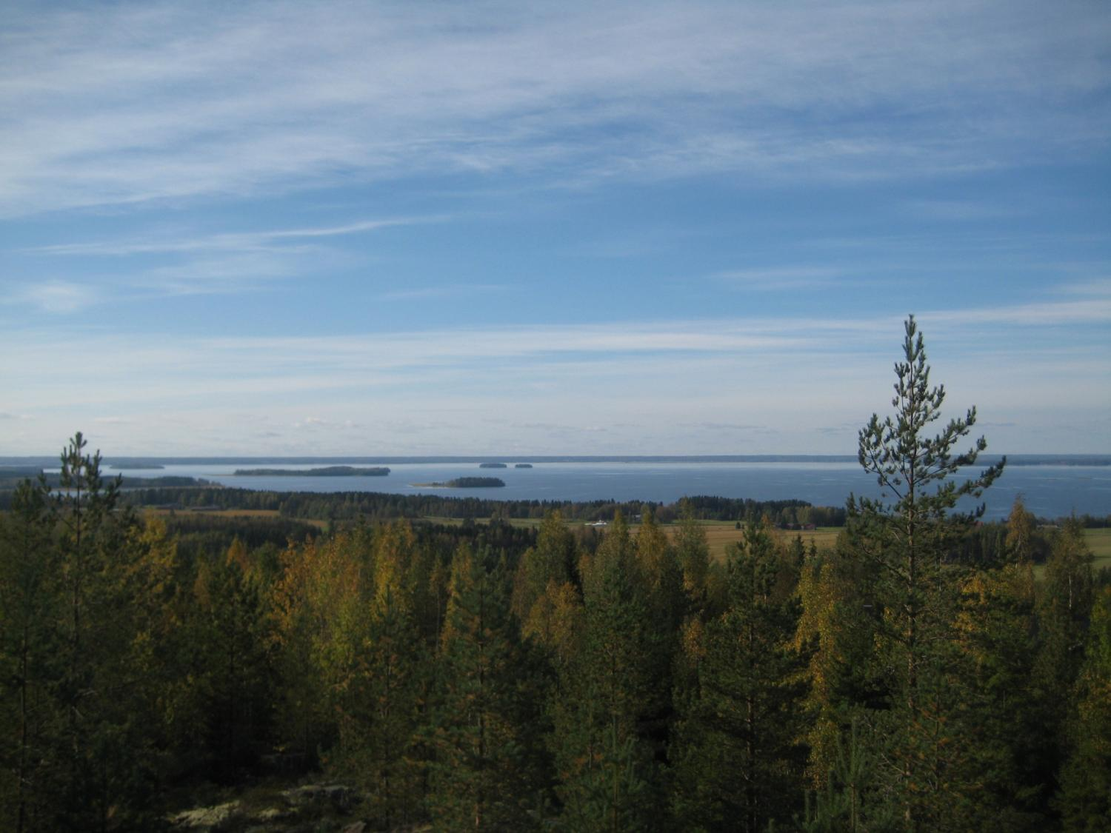

From Geology to Geotrails Examples from Lappajärvi and Simpsiö, western Finland Geologiasta georeittejä
And Out We Go! — Leader Webinar
February 18th, 2021
Teemu Öhman
Arctic Planetary Science Institute
teemu.ohman@planetaryscience.fi
http://kuusta.blogspot.com/
Twitter: @OhmanTeemu
T. Öhman
Opinions are obviously mine only.

Slide 2
Geotourism?
Many definitions, including:
“A form of natural area tourism that specifically focuses on landscape and geology. It promotes tourism to geosites and the conservation of geodiversity and an understanding of Earth sciences through appreciation and learning. This is achieved through independent visits to geological features, use of geotrails and view points, guided tours, geo-activities and patronage of geosite visitor centers". (Newsome & Dowling, 2010)

Slide 3
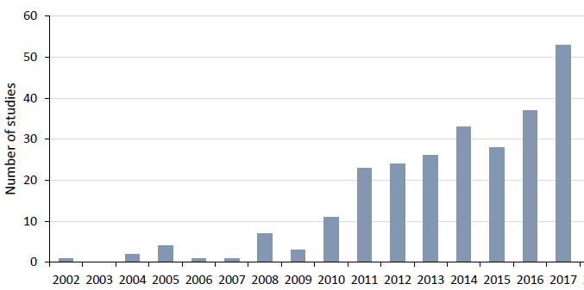
Number of peer-reviewed papers on geotourism (Ólafsdóttir & Tverijonaite, 2018)

Slide 4

UNESCO Global Geopark?
“Unified geographical areas where sites and landscapes of international geological significance are managed with a holistic concept of protection, education and sustainable development.”
Global Geoparks Network 1998, UNESCO support 2001, UNESCO Global Geoparks 2015
Not a conservation / protected area
161 UNESCO Global Geoparks in 44 countries, two in Finland, none in Sweden or Estonia
Rokua, 2010
Lauhanvuori—Hämeenkangas, 2020
Saimaa likely to be accepted 2021?
Other projects include Salpausselkä and Impact Crater Lake Geopark project around Lappajärvi crater

Slide 5
The unique ancient Fennoscandian bedrock (crystalline basement)
”Suomessa me emme oikein tajua tätä erikoisuutta. Keski-Euroopan tai vaikka Viron luontoihmiset ovat aivan ihastuksissaan, kun näkevät kiteistä peruskalliota kallioleikkauksissa moottoriteillämme.”
– Dr. Heikki Simola, paleoecologist, Univ. Eastern Finland, 12.12.2020 (https://yle.fi/uutiset/3-11681380)
+ Glacial terrain (completely missing in, e.g., central Europe or Asia)
Things that are ordinary to us are exotic to almost everyone else!

Slide 6
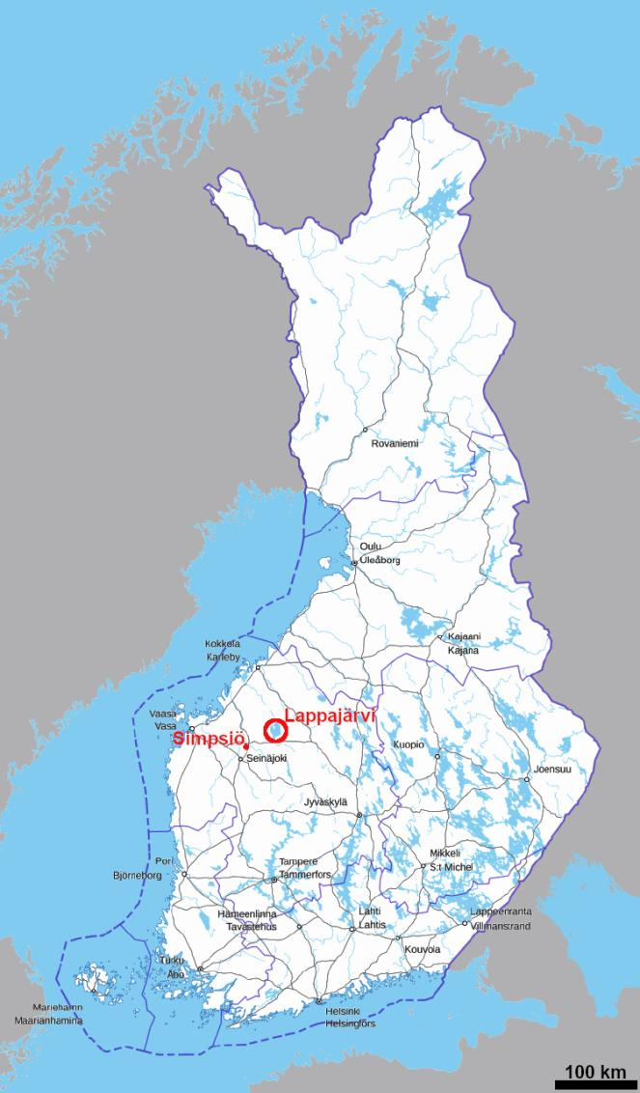
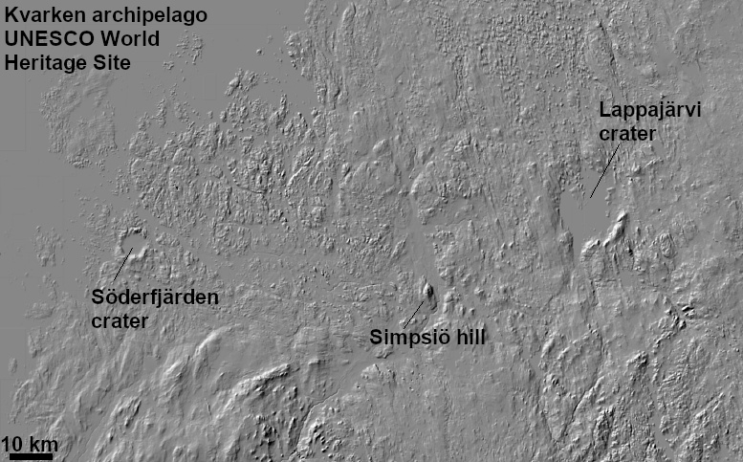
Lappajärvi & Simpsiö
Located in western Finland in Southern Ostrobothnia
Bothian Sea – Bottenhavet – Selkämeri
MML / Paikkatietoikkuna
MML / Paikkatietoikkuna / T. Öhman

Slide 7
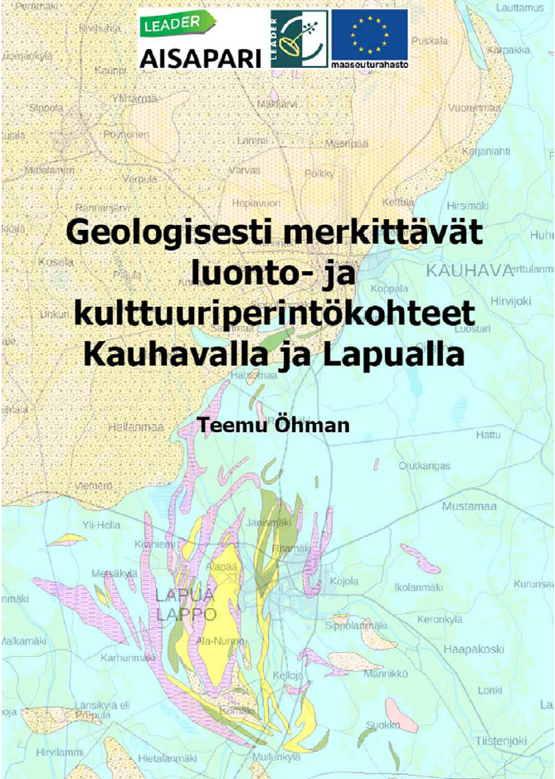
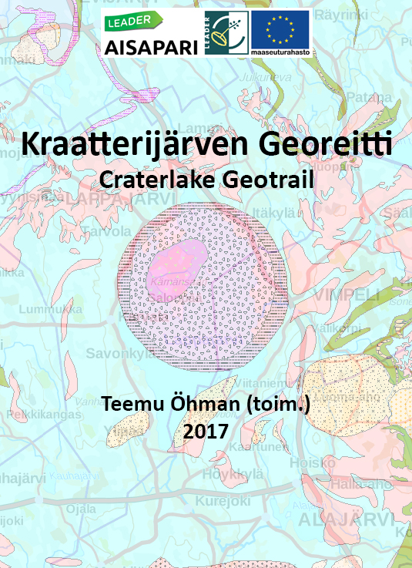

Slide 8
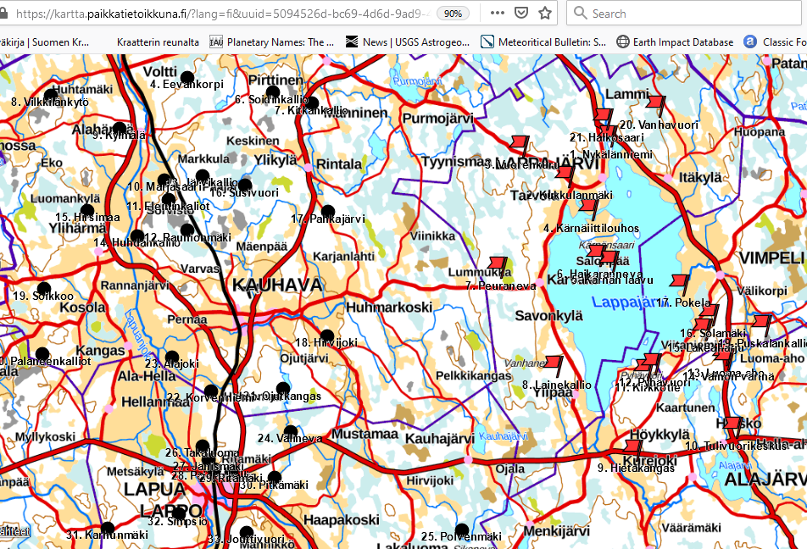
Lappajärvi (& Lapua—Kauhava) maps online

Slide 9
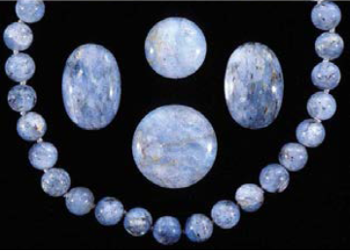
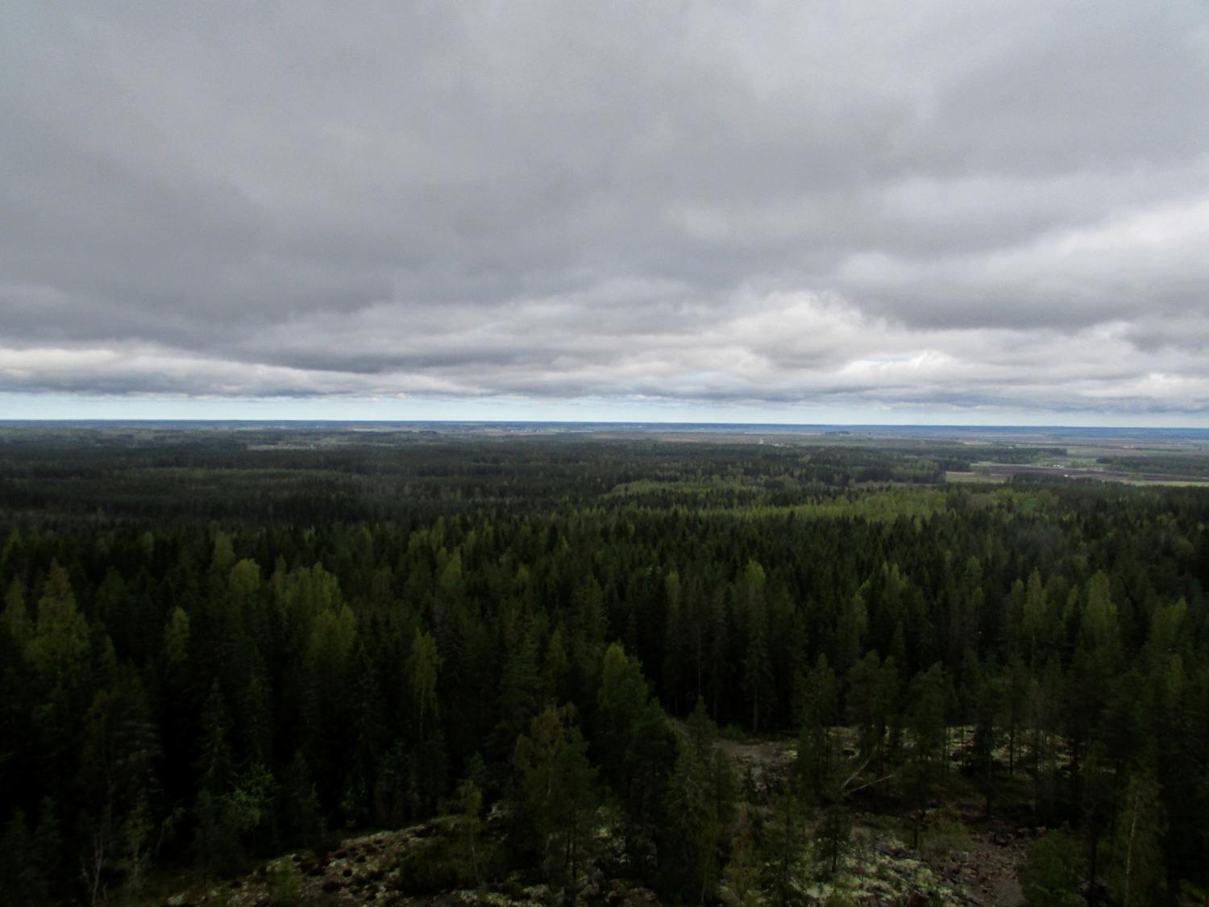
Simpsiö hill, Lapua
~5.5 x 2 km oval-shaped hill ~100 m above the surrounding terrain
Finland’s largest metachert formation; some rare minerals, including gem material (e.g., blue quartz)
Bedrock and glacial history similar to that in Lappajärvi area
Nature conservation area, slalom slope, observation tower, rich history, nature trails with some (out-of-date) geology signs
J. Väätäinen / GTK / Hietala 2017
T. Öhman

Slide 10
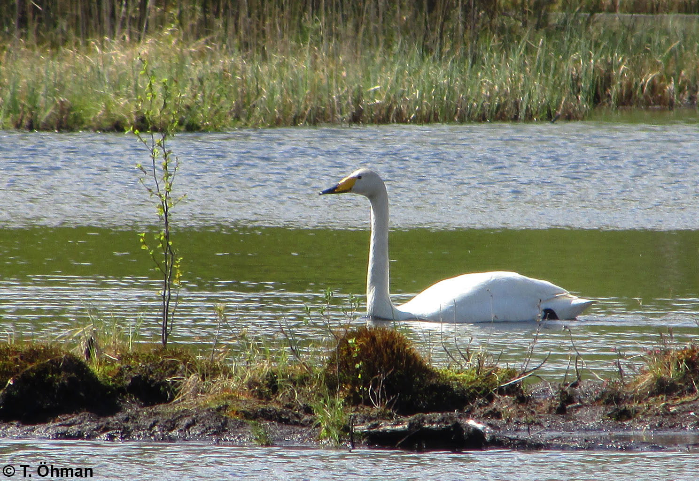

Slide 11
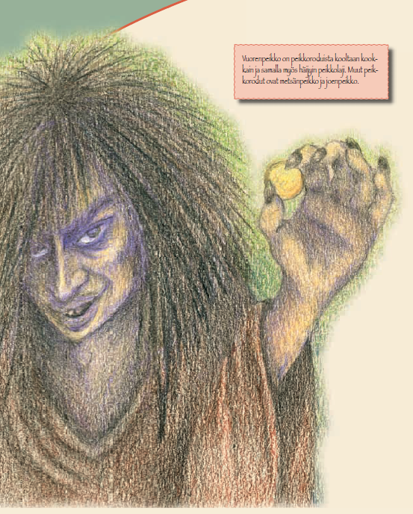
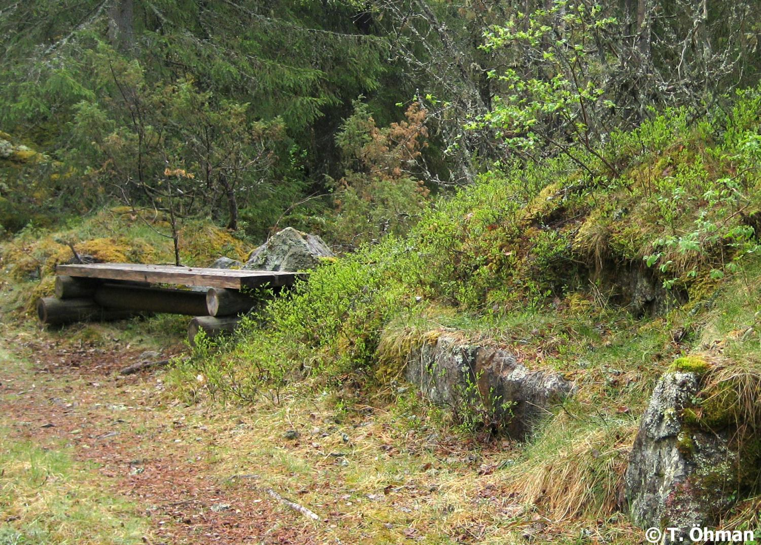
Myths & legends
Simpsiö and Lappajärvi share a common mythology of trolls and bishops / priests / clergymen
→ Geotrails are not just about geology!
Bishop’s Bench
Lapua.fi / Susanna Alakarhu

Slide 12
Lappajärvi impact crater
Diameter: 22 km, uplifted rim preserved ~100 m above the surface of lake Lappajärvi
Age: 78 million years (the youngest in Nordic countries; geologically very young compared to 3500—1500 million years old Finnish bedrock)
Unique impact-related rocks preserved
Studied since 1858; first proven impact crater in Finland (1968; one of the first in Fennoscandia); first impact diamonds in Fennoscandia (1998)
Geosites around the crater mapped in 2016—17
→ geotrail

Slide 13
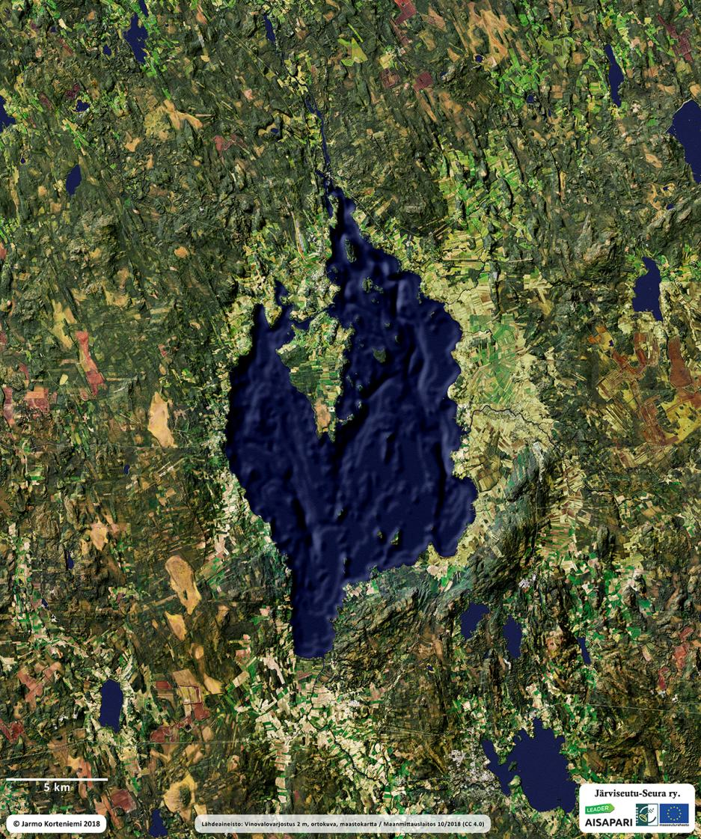
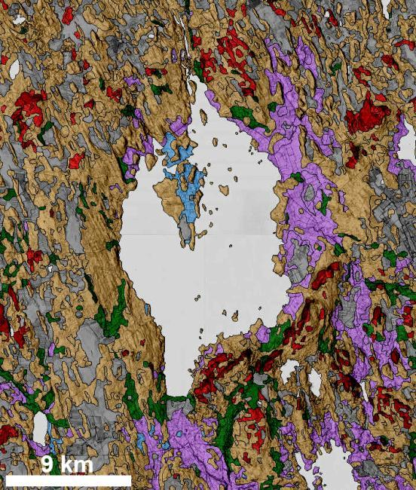
Lappajärvi
Aerial photo + topography & bathymetry
Surficial deposits + topography
GTK / MML / T. Öhman

Slide 14
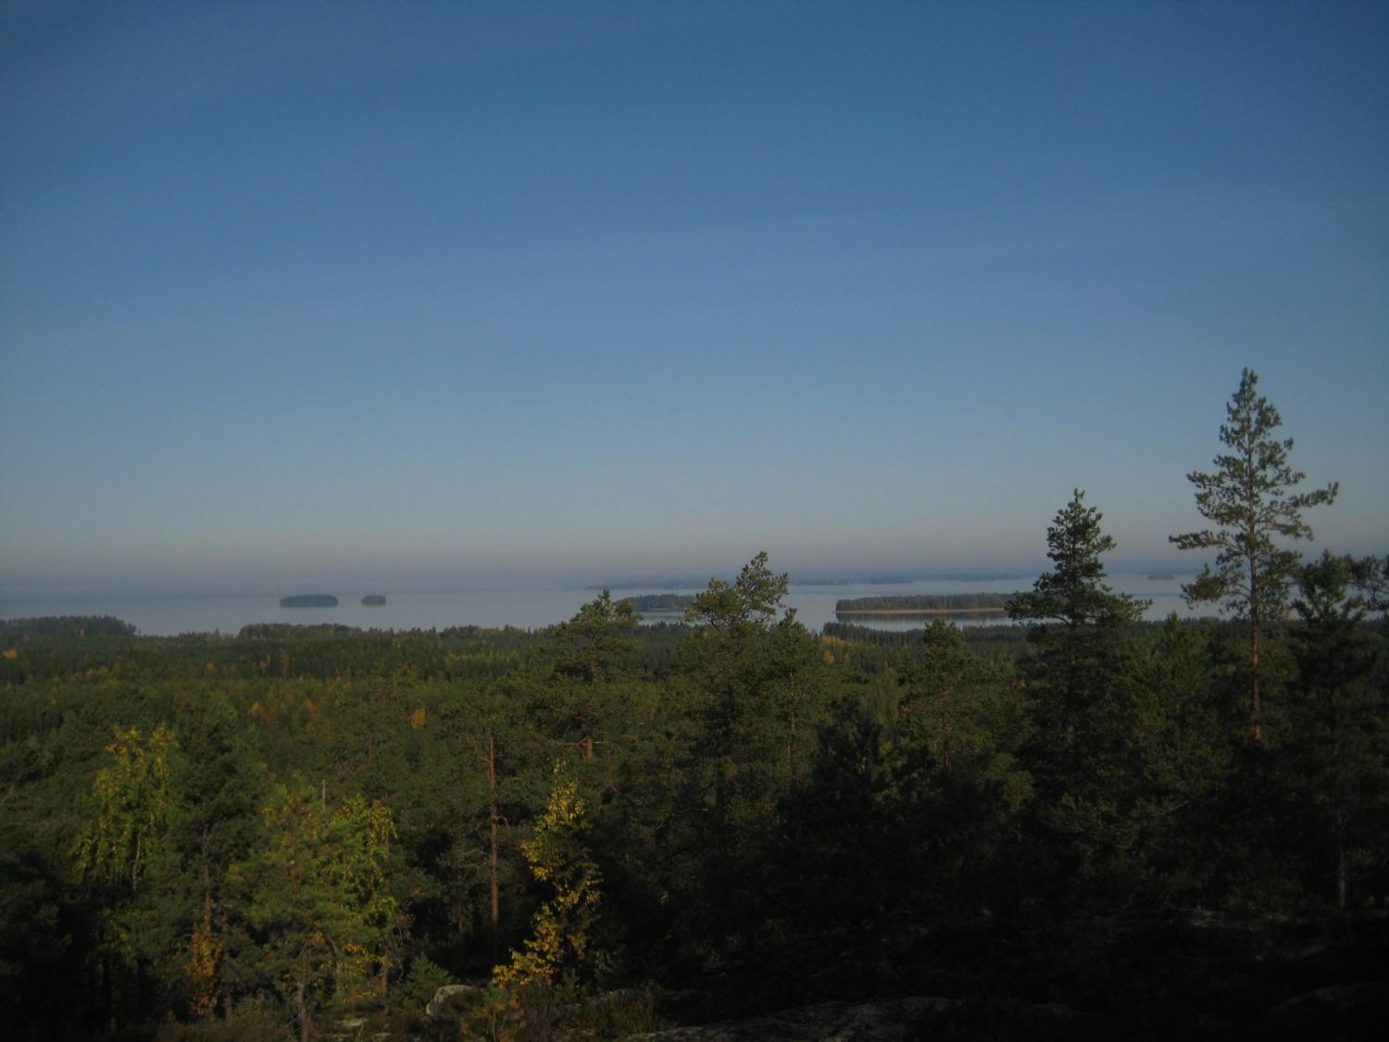
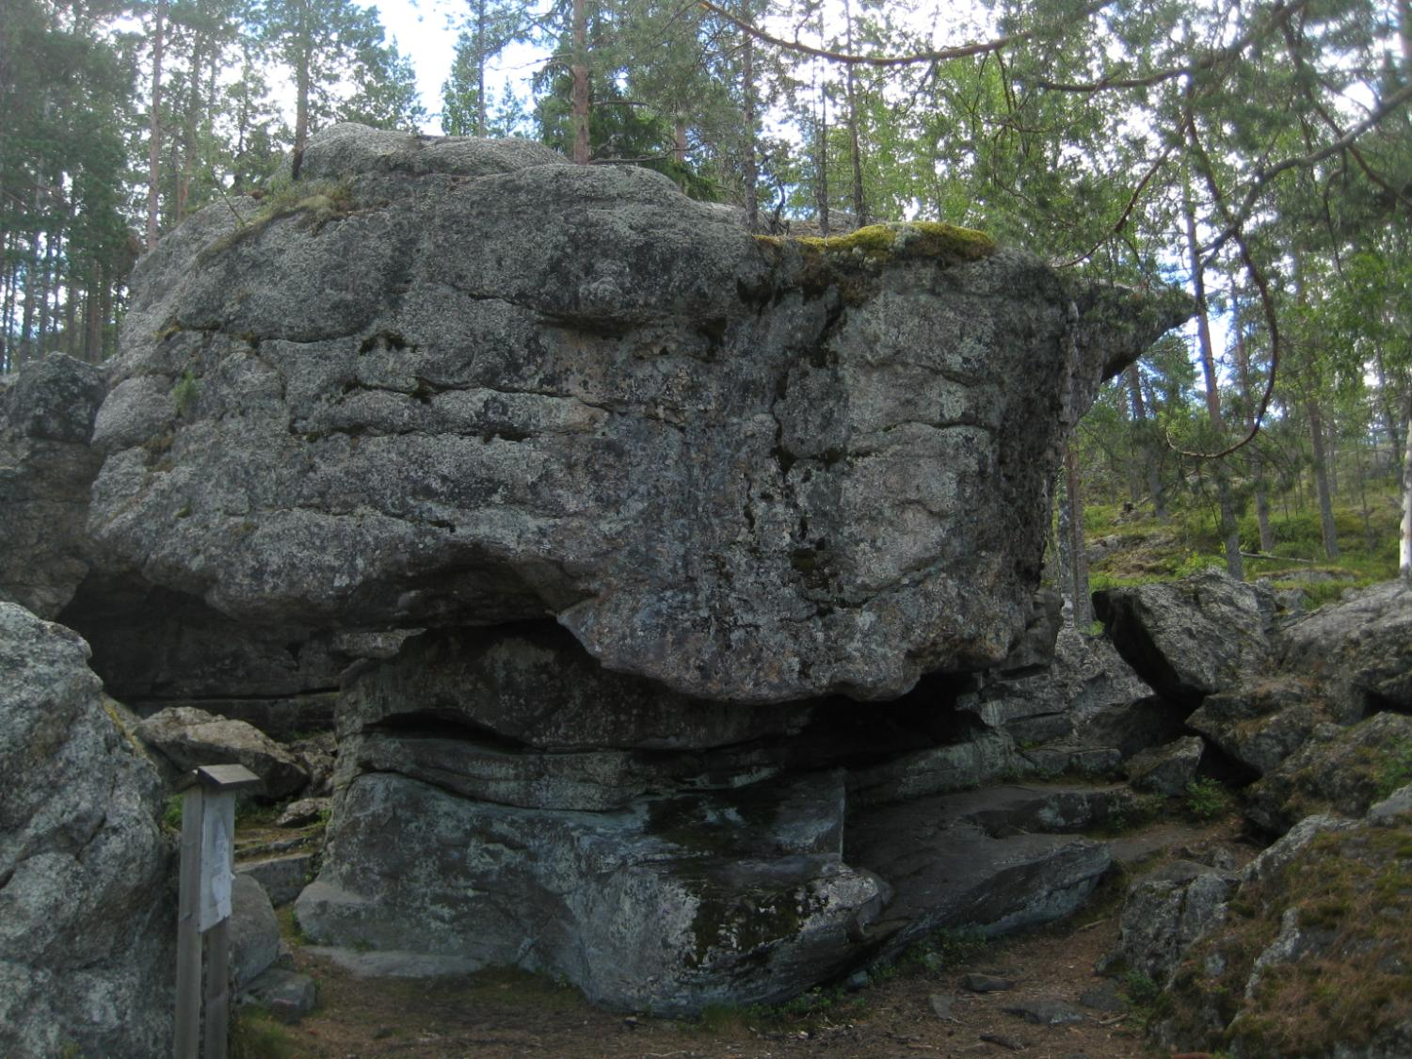
A hiking trail along the eastern rim of Lappajärvi crater
A rauk (sea stack) in Pyhävuori, where Sámi children were sacrificed.
T. Öhman
T. Öhman

Slide 15
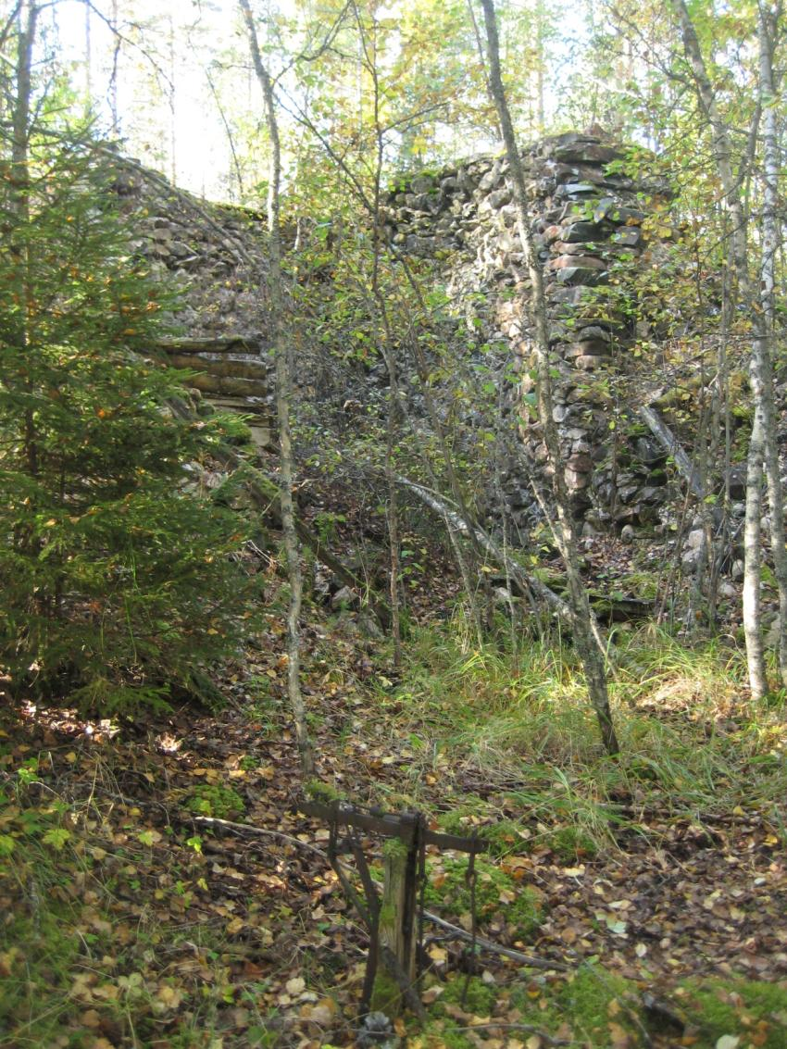
Limestone and historic lime kilns
Exceptionally long tradition of small-scale lime burning
Geology directly affects vegetation, agriculture and human history
Geodiversity forms the basis of biodiversity!
T. Öhman

Slide 16
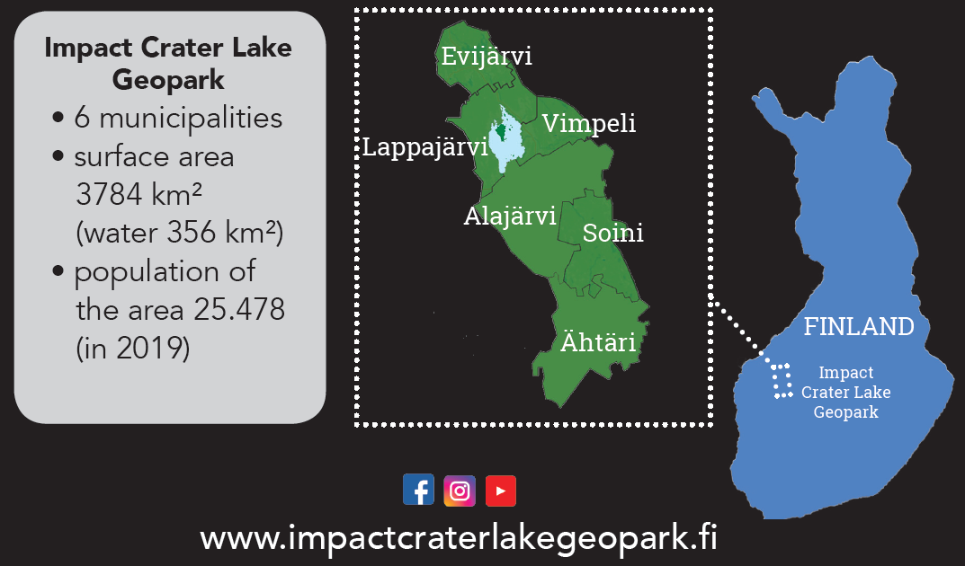
Impact Crater Lake Geopark -project
Southeastern parts of the project area have quite different bedrock and surficial (glacial ) deposits (also crosses the main watershed in Finland)

Slide 17
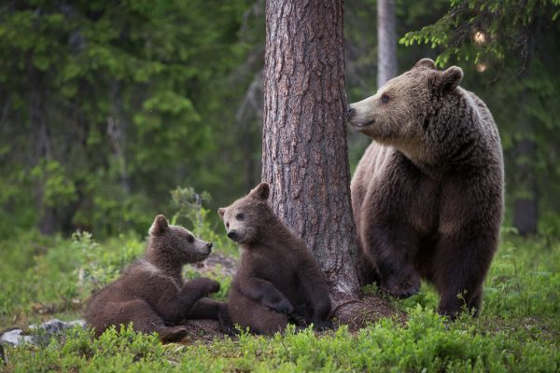
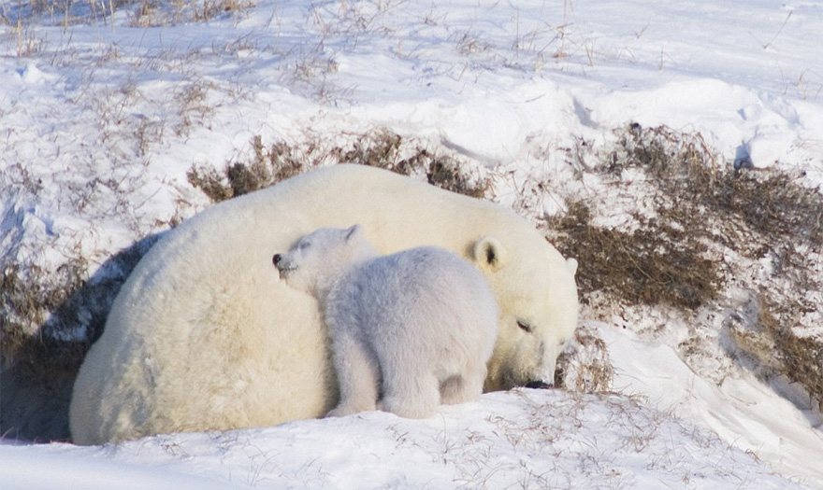
Get the names right
Geosciences use ridiculous amounts of unnecessarily complicated words
→ simplify!
However: You still need to use the right words!
E.g., the Simpsiö “metachert” was formed in an environment totally different from a “quartzite” (as it is often still called)
→ different story to tell!
Steve Kazlowski
Emilia Milonoff

Slide 18
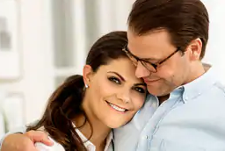
Get the numbers right
Grattis på bröllopsdagen, min prinsessa!
Tack tack, men det var nästan tre månader sedan...
https://www.newmyroyals.com/2019/02/princess-victoria-and-daniel-engagement.html

Slide 19
Difference between geotrails and ordinary nature trails
In geosciences fundamental interpretations and age determinations can change drastically (likely more than in, e.g., zoology or botany)
→ keep up with the latest research!
→ Threat: Signs and exhibitions need to be easily updateable (→ need for funding and personnel)
→ Opportunity: A dynamic, changing field of science is more interesting to visitors

Slide 20
Geotrail summary
Lots of unused potential
Geotourism is a rapidly growing field, even among nature tourism
What seems ordinary to us is highly exotic to people even from nearby areas, e.g., central Europe

Slide 21
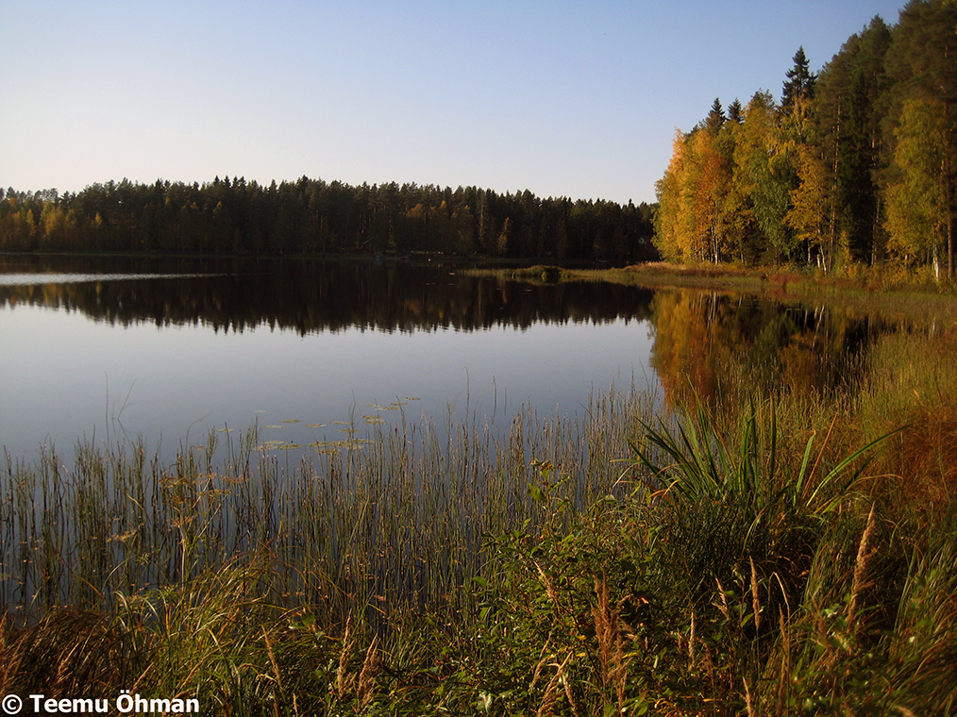

Links & thanks
Lappajärvi crater geotrail
https://intolinkki.net/georeitti/
https://kraatterijarvigeopark.fi/
Lapua & Kauhava geosites (incl. Simpsiö)
https://intolinkki.net/kauhavan-ja-lapuan-geokohteet/
Simpsiö nature trail
https://lapua.fi/asuminen-ja-ymparisto/puistot-ulkoilualueet-ja-metsat/simpsion-luontopolut/
Thank you for your attention! Any questions?
Thanks to:

