Slide 1
Safety and Rules in the Hiking Trails & Outdoor Areas
Minna Boström
I samma båt-samassa veneessä rf ry Leader Action Group
www.sameboat.fi
Facebook: @sameboatLAG

Slide 2
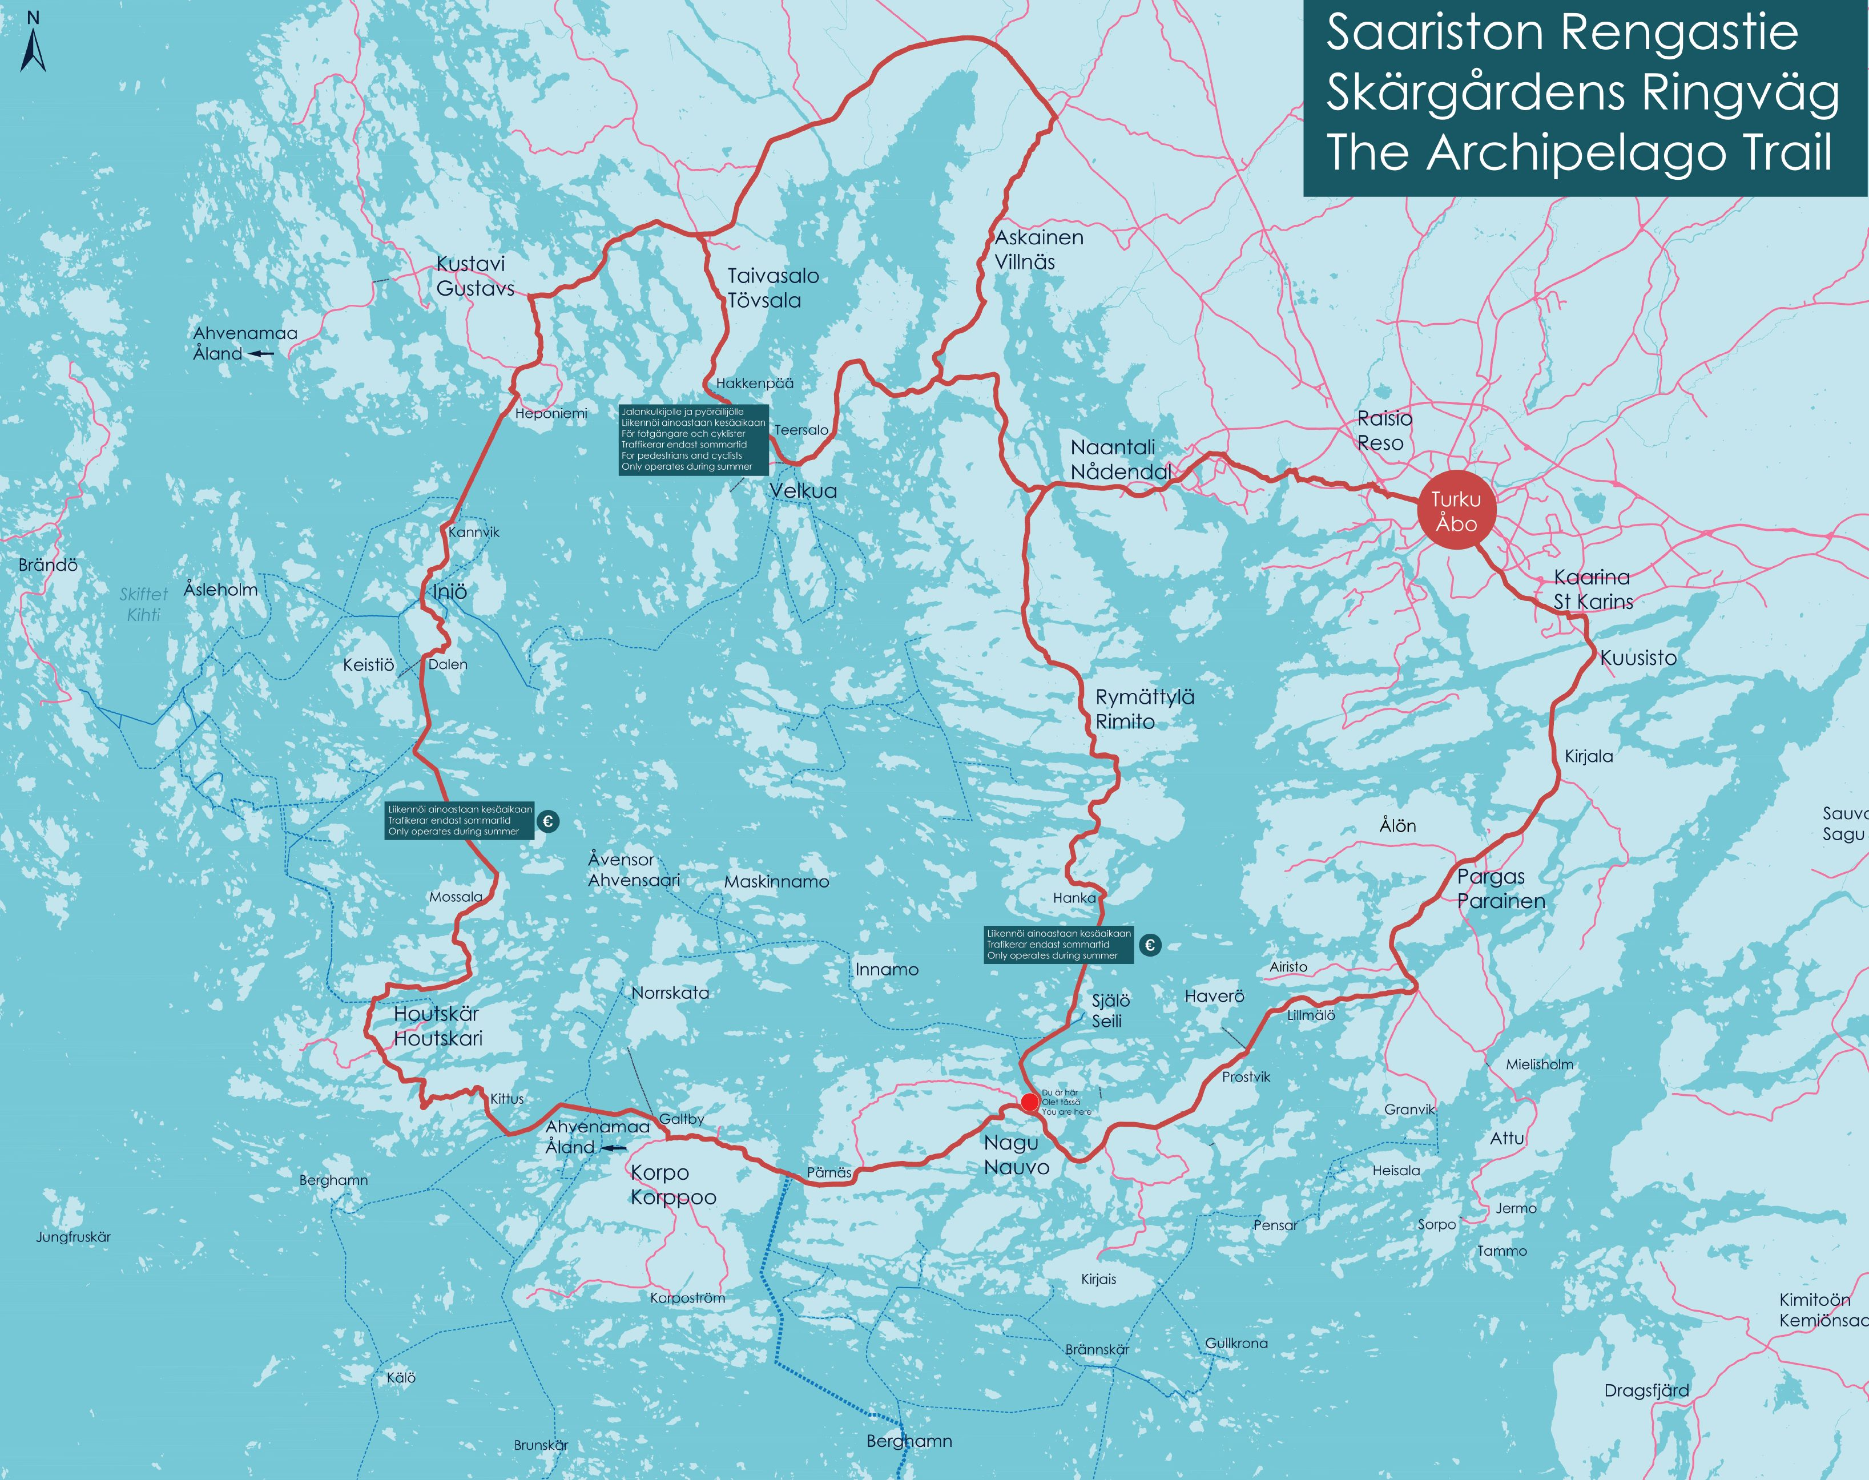
Background
I samma båt LAG participated in the joint Outdoor Leader project with a local action that aimed at mapping nature trails and resting places along The Archipelago Trail in the part that goes through the municipalities Parainen and Kustavi.
The field work and reports were made by our project worker Sara Söderlund.

Slide 3
Why?
Nature trails and constructions associated with them are open to all visitors, and serve as good local projects with a large user group.
They can be used by local people, by tourists, by local companies and by visitors.
We did this project to inspire and help local organisations to start planning new or developing old nature trails in the area.

Slide 4
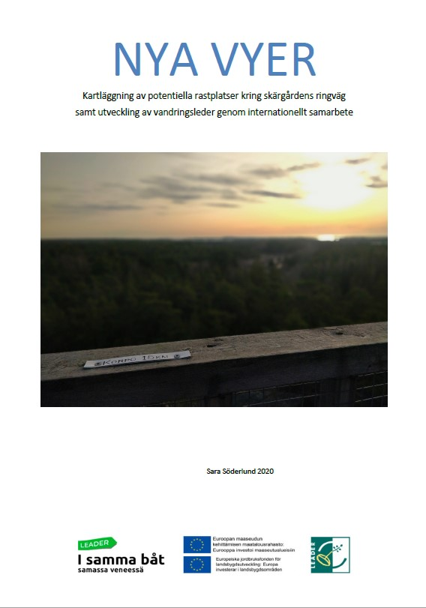
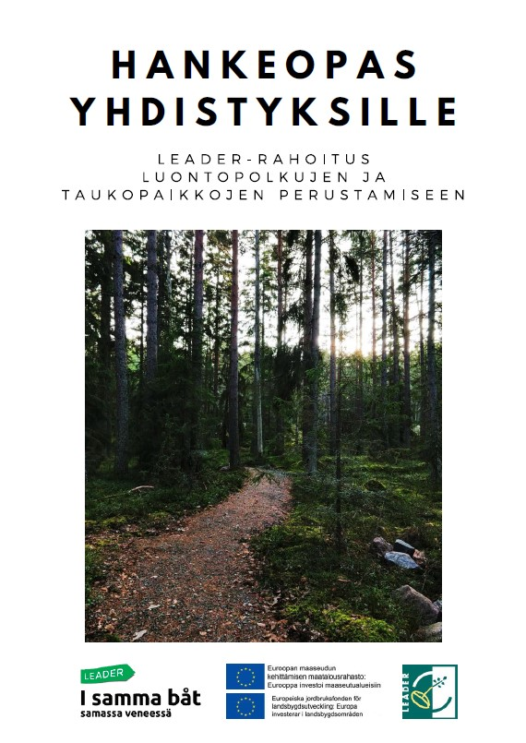
What did we do?
A report with the project results (in Swedish)
A handbook for project applicants about what to think about when planning a nature trail and applying for Leader-funding for it (in Finnish and Swedish)
A video about safety issues at nature trails (in Swedish and Finnish)
All material is found at our website https://www.sameboat.fi/materiaalipankki-2/
(in Swedish) or https://www.sameboat.fi/materiaalipankki/ (in Finnish).
An article about the project, and the video is found on the website under Hanke-esimerkit (in Finnish) och Projektexempel (in Swedish)

